Slide 1
SDMAY25-10
PROJECT
PLANNING
TESSA LANZEL, PAIGE SCHNEIDER, MOLLY ROONEY, MAY EDEL, ELICIA BARANOWSKI, ALEXANDRA RAUER, JOSHUA STEVEN CHIANG

Slide 2
OVERVIEW
Develop a mobile application for both Google Play Store and Apple App store using their native language
Apps will connect to existing firmware and database to display and store user’s force output for each lift and metrics over a period of time

Slide 3
PROBLEM
Unknown knowledge for what weights will improve strength without injuring
Current data is not transferable across devices
No security
Current Application is full of bugs
Availability to users

Slide 4
PROJECT MANAGEMENT
AGILE
Regular meetings with client to gather feedback and make changes
Iterative approach to developing both applications
Features can be released without waiting for a different part of the project to be completed
Development is a measure of progress than than hitting a specific development milestone
We are encouraged to get as much done as reasonable given the timeframe

Slide 5
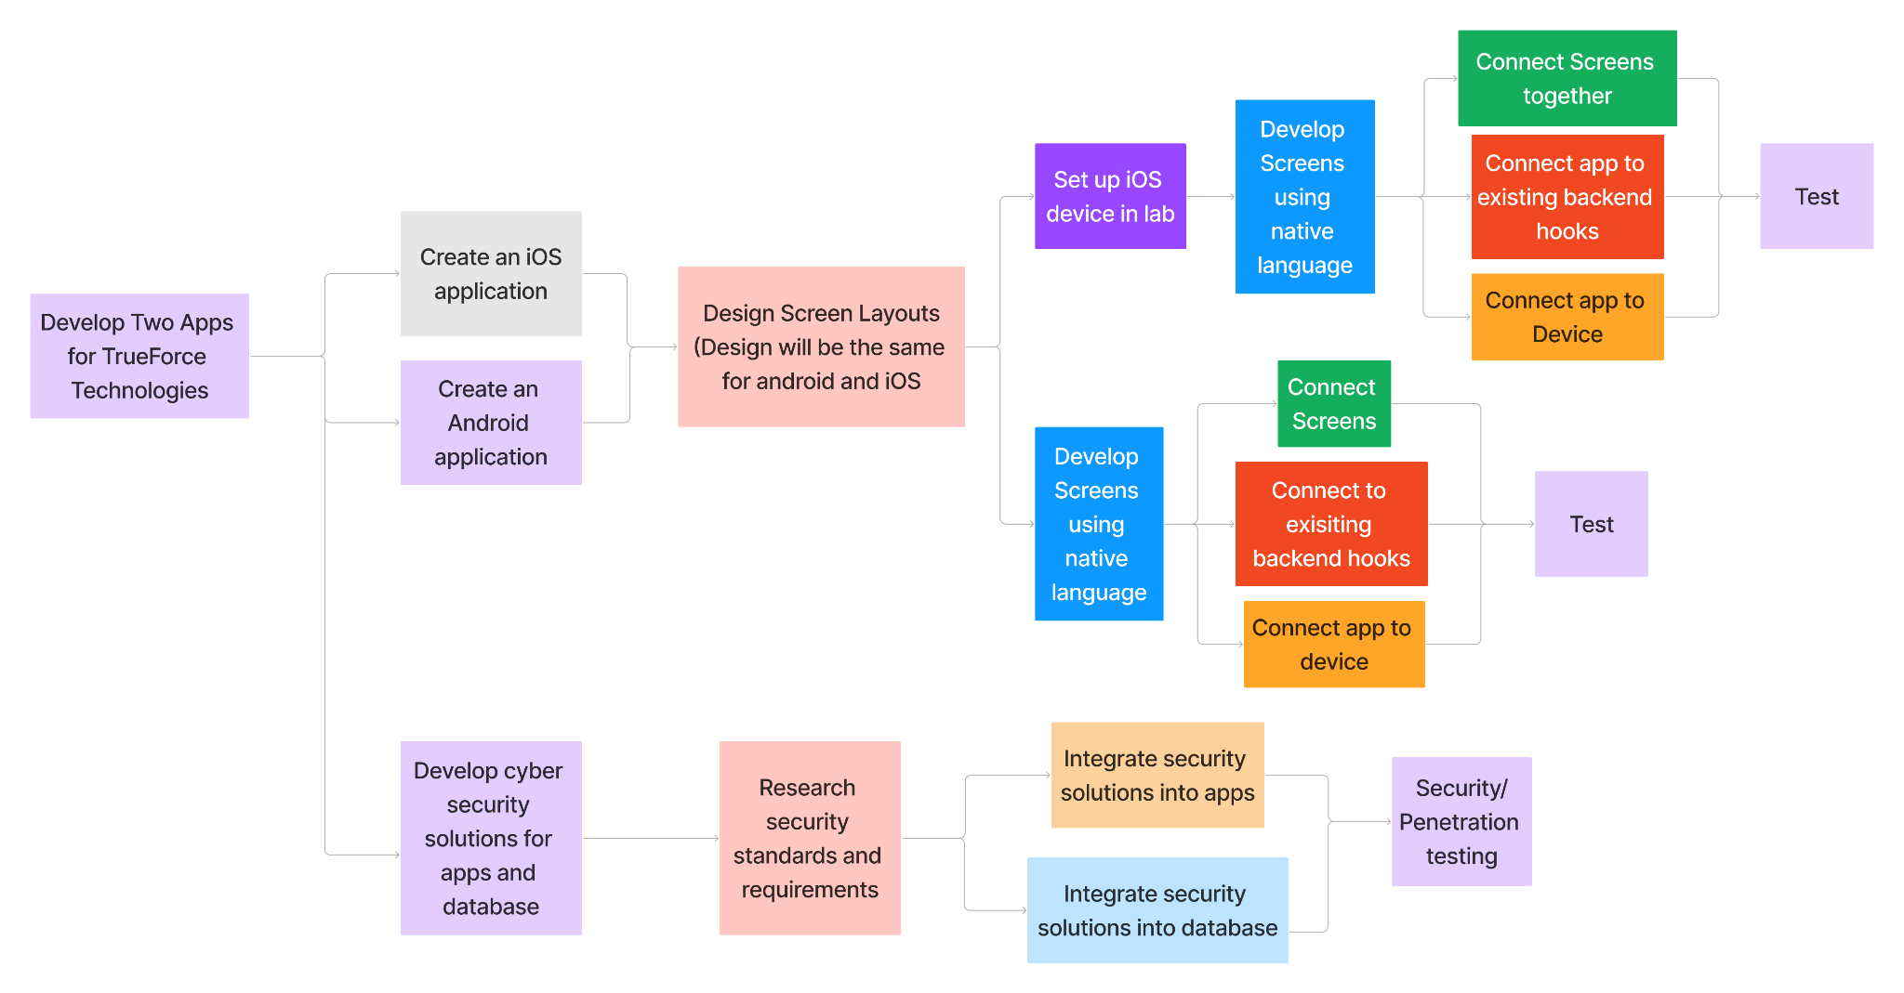
TASK DECOMPOSITION

Slide 6
KEY MILESTONES
MILESTONES, METRICS, & EVALUATION CRITERIA
Cyber Security is successfully implemented
Secure the backend database
Remove any security vulnerabilities from application
Evaluation Criteria: Different coaches are unable to view other teams data, and certain brute force attacks are prevented
App can connect to rack
Bluetooth connection works with different devices
Evaluation Criteria: Device can connect within 30 seconds, notifies user if failed
Screen Designs Implemented
All current designs coded in both Android and iOS
100% of current screens implemented in new applications
Evaluation Criteria: Meets Client Standards and Expectations

Slide 7
KEY RISKS
RISK & RISK MITIGATION STRATEGIES
Backend Connectivity
Unable to get the API hooks from the current development team to connect our screen designs to the hardware on the rack
Mitigation: Alerted the client of necessary database information needed so advisor and client can work towards delivering them to us
Likelihood: unlikely
Consequences: Major (No data could be stored or retrieved making our project unusable)
Hardware Connectivity
Unable to connect to the Force Rack through the Bluetooth stack, the team does not work on the hardware portion of the product
Mitigation: Planned out minor testing in parallel with app feature development to frequently check the connection status as more functionality is added to the application, enabling the team to notify the advisor if there are issues
Likelihood: Moderate
Consequences: Major (App would not receive any athlete data)

Slide 8
CONCLUSIONS
Agile development management to meet client’s changing needs and be able to add features later
Key Milestones
Implementation security features
Connect app the the rack
Implement screen design and functionality
Key Risks
Backend Connection
Hardware Connectivity

Slide 9
QUESTIONS?

